Slide 1
SLA Management in Cloud Computing
Inspiration
Types of SLA
Life cycle of SLA
SLA Management in the cloud

Slide 2
Inspiration
Early days of web-application deployment - performance of the application - was single important criterion for provisioning server resources (during peak time).
Provisioning (in those days) involved
- deciding hardware configuration,
- determining the number of physical machines &
- acquiring them upfront.
Web applications were hosted on these dedicated individual servers within enterprises’ own server rooms.
- These web applications were used to provide different kinds of e-services to various clients.
Typically, the service-level objectives (SLOs) for these applications
- response time & throughput of the application end-user requests.
Note: Activity of determining the number of servers and their capacity that could satisfactorily serve the application end-user requests at peak loads is called capacity planning.

Slide 3
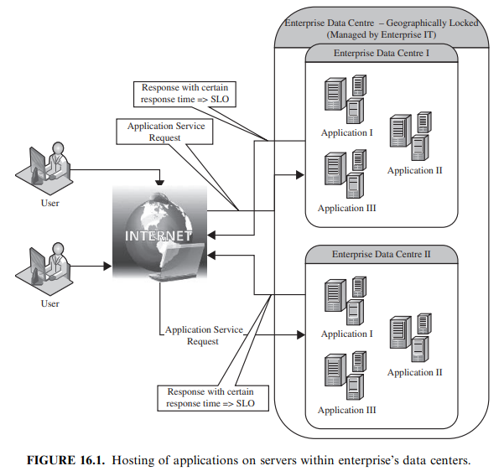
An example scenario where two web applications, application A and application B, are hosted on a separate set of dedicated servers within the enterprise-owned server rooms is shown in Figure 16.1.
As the number of web applications grew - server rooms in the organization became large and such server rooms were known as data centers.
- These data centers were owned and managed by the enterprises themselves.

Slide 4
Over the course of time - number of web applications and their complexity have grown.
- Therefore, the complexity of managing the data centers also increased.
Accordingly, enterprises realized - it was economical to outsource the application hosting activity to third-party infrastructure providers
Enterprises developed the web applications & deployed on the infrastructure of the third-party service providers.
It necessitated the enterprises to enter into a legal agreement with the infrastructure service providers to guarantee a minimum quality of service (QoS).
Typically, QoS parameters are related to the availability of the system CPU, data storage, and network for efficient execution of the application at peak loads.
This legal agreement is known as the service-level agreement (SLA).
Ex: One SLA may state that the application’s server machine will be available for 99.9% of the key business hours of the application’s end users, also called core time, and 85% of the non-core time.
Another SLA may state that the service provider would respond to a reported issue in less than 10 minutes during the core time, but would respond in one hour during non-core time.

Slide 5
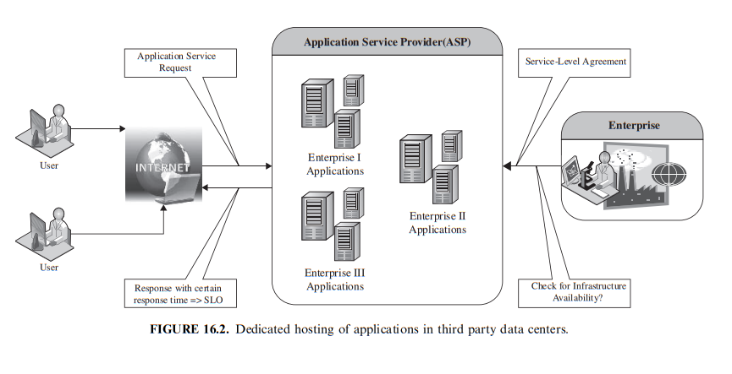
These SLAs are known as the infrastructure SLAs, and the infrastructure service providers are known as Application Service Providers (ASPs).
This scenario is depicted in Figure 16.2, where the enterprise applications are hosted on the dedicated servers belonging to an ASP.

Slide 6
Dedicated hosting practice - resulted in massive redundancies - due to the underutilization of many of their servers.
- because the applications were not fully utilizing their servers’ capacity at nonpeak loads.
To reduce redundancies & increase the server utilization in data centers, ASPs started co-hosting applications with complementary workload patterns.
Co-hosting of applications means deploying more than one application on a single server.
- led to further cost advantage for both the ASPs and enterprises.
Figure 16.3 shows the enterprise and the third-party perspective before and after the applications are co-located.
Figure 16.3a & Figure 16.3c - underutilized capacity of a server during dedicated hosting.
However, Figure 16.3b shows the scenario when the same system is multiplexed between two applications, application A and application B; and the capacity of the server visible to the enterprise owning application A is only the amount consumed by it.
However, Figure 16.3d depicts the ASP’s perspective of the server capacity utilization when two applications, application A and application B, having complementary workload patterns are co-located.

Slide 7
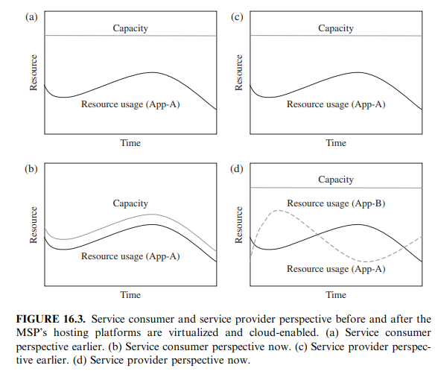

Slide 8
However, newer challenges
- application performance isolation & security guarantees
- have emerged and needed to be addressed.
Performance isolation - one application should not steal the resources being utilized by other co-located applications.
Similarly, one application should not access and destroy the data and other information of co-located applications.
Hence, appropriate measures are needed to guarantee security and performance isolation.
- These challenges prevented ASPs from fully realizing the benefits of co-hosting.
Virtualization technologies have been proposed to overcome the above challenges

Slide 9
The applications, instead of being hosted on the physical machines, can be encapsulated using virtual machines
  - These virtual machines are then mapped to the physical machines.
System resource allocation to these virtual machines can be made in two modes: (1) conserving & (2) nonconserving
Conserving mode - a virtual machine demanding more system resources (CPU and memory) than the specified quota cannot be allocated the spare resources that are remain un-utilized by the other co-hosted virtual machines.
Nonconserving mode - spare resources that are not utilized by the co-hosted virtual machines can be used by the virtual machine needing the extra amount of resource.
If the resource requirements of a virtual machine cannot be fulfilled from the current physical host, then the virtual machine can be migrated to another physical machine capable of fulfilling the additional resource requirements.
This new development enabled the ASPs to allocate system resources to different competing applications on demand.

Slide 10
Adoption of virtualization technologies - required ASPs to get more detailed insight into the application runtime characteristics with high accuracy.
Based on these characteristics, ASPs can allocate system resources more efficiently to these applications on-demand, so that application-level metrics can be monitored and met effectively.
- These metrics are request rates and response times.
Therefore, different SLAs than the infrastructure SLAs are required.
These SLAs are called application SLAs. These service providers are known as Managed Service Providers (MSP) because the service providers were responsible for managing the application availability too.
This scenario is shown in Figure 16.4, where both application A and application B share the same set of virtualized servers.
- To fulfill SLOs mentioned in the application SLA & also make their IT infrastructure elastic, an in-depth understanding of the application’s behavior is required for the MSPs.

Slide 11
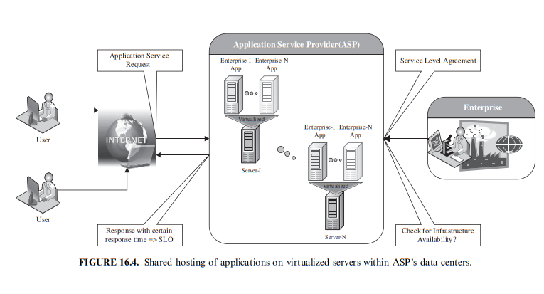

Slide 12
Types of SLA
Service-level agreement provides a framework within which both seller and buyer of a service can pursue a profitable service business relationship.
It outlines the broad understanding b/w service provider & service consumer - forms the basis for maintaining a mutually beneficial relationship.
From a legal perspective, the necessary terms and conditions that bind the service provider to provide services continually to the service consumer are formally defined in SLA.
SLA can be modeled using web service-level agreement (WSLA) language specification [7]. Although WSLA is intended for web-service-based applications, it is equally applicable for hosting of applications.
Service-level parameter, metric, function, measurement directive, service-level objective, and penalty are some of the important components of WSLA and are described in Table 16.1

Slide 13
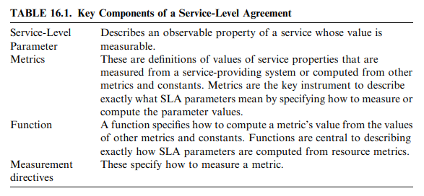

Slide 14
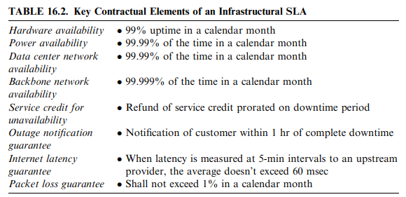
There are two types of SLAs from the perspective of application hosting:
(1) Infrastructure SLA
- The infrastructure provider manages & offers guarantees on availability of the infrastructure, namely, server machine, power, network connectivity, and so on.
- Enterprises manage themselves, their applications that are deployed on these server machines.
- The machines are leased to the customers & are isolated from machines of other customers.
- In such dedicated hosting environments, a practical example of service-level guarantees offered by infrastructure providers is shown in Table 16.2.

Slide 15
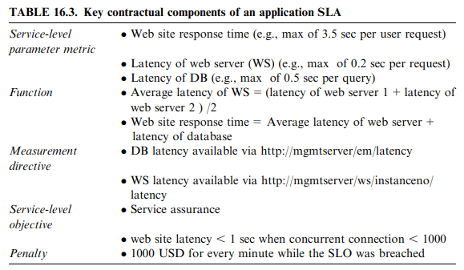
(2) Application SLA
- In the application co-location hosting model, the server capacity is available to the applications based solely on their resource demands.
- Hence, the service providers are flexible in allocating and de-allocating computing resources among the co-located applications.
- Therefore, the service providers are also responsible for ensuring to meet their customer’s application SLOs.
- For example, an enterprise can have the following application SLA with a service provider for one of its application, as shown in Table 16.3.

Slide 16
It is also possible for a customer and the service provider to mutually agree upon a set of SLAs with different performance and cost structure rather than a single SLA.
The customer has the flexibility to choose any of the agreed SLAs from the available offerings.
At runtime, the customer can switch between the different SLAs.
However, from the SLA perspective there are multiple challenges for provisioning the infrastructure on demand.

Slide 17
These challenges are as follows:
(a). The application is a black box to the MSP and the MSP has virtually no knowledge about the application runtime characteristics.
(b). The MSP needs to understand the performance bottlenecks and the scalability of the application.
(c). The MSP analyzes the application before it goes on-live. However, subsequent operations/enhancements by the customer’s to their applications or auto updates beside others can impact the performance of the applications, thereby making the application SLA at risk.
(d). The risk of capacity planning is with the service provider instead of the customer. If every customer decides to select the highest grade of SLA simultaneously, there may not be a sufficient number of servers for provisioning and meeting the SLA obligations of all the customers.

Slide 18
Life cycle of SLA
Each SLA goes through a sequence of steps starting from identification of terms and conditions, activation and monitoring of the stated terms and conditions, and eventual termination of contract once the hosting relationship ceases to exist.
Such a sequence of steps is called SLA life cycle and consists of the following five phases:
1. Contract definition
2. Publishing and discovery
3. Negotiation
4. Operationalization
5. De-commissioning
Contract Definition:
- Service providers define a set of service offerings & corresponding SLAs using standard templates.
- These service offerings form a catalog.
- Individual SLAs for enterprises can be derived by customizing these base SLA templates.

Slide 19
Publication and Discovery:
- Service provider advertises these base service offerings through standard publication media, and the customers should be able to locate the service provider by searching the catalog.
- The customers can search different competitive offerings and shortlist a few that fulfill their requirements for further negotiation.
Negotiation:
- Once the customer has discovered a service provider who can meet their application hosting need, the SLA terms and conditions needs to be mutually agreed upon before signing the agreement for hosting the application.
- For a standard packaged application which is offered as service, this phase could be automated.
- For customized applications that are hosted on cloud platforms, this phase is manual.
- Service provider needs to analyze the application’s behavior with respect to scalability & performance before agreeing on the specification of SLA. At the end of this phase, the SLA is mutually agreed by both customer and provider and is eventually signed off.

Slide 20
Operationalization:
- SLA operation consists of SLA monitoring, SLA accounting, and SLA enforcement.
- SLA monitoring involves measuring parameter values and calculating the metrics defined as a part of SLA and determining the deviations.
- SLA accounting involves capturing and archiving the SLA adherence for compliance. Apart from the frequency and the duration of the SLA breach, it should also provide the penalties paid for each SLA violation.
- SLA enforcement involves taking appropriate action when the runtime monitoring detects a SLA violation.
The different policies can be expressed using a subset of the Common Information Model (CIM).
- CIM model is an open standard that allows expressing managed elements of data center via relationships and common objects.
De-commissioning:
- SLA decommissioning involves termination of all activities performed under a particular SLA when the hosting relationship between the service provider and the service consumer has ended.

Slide 21
SLA Management in the Cloud
SLA management of applications hosted on cloud platforms involves five phases:
1. Feasibility
2. On-boarding
3. Pre-production
4. Production
5. Termination
Different activities performed under each of these phases are shown in Figure 16.7.

Slide 22
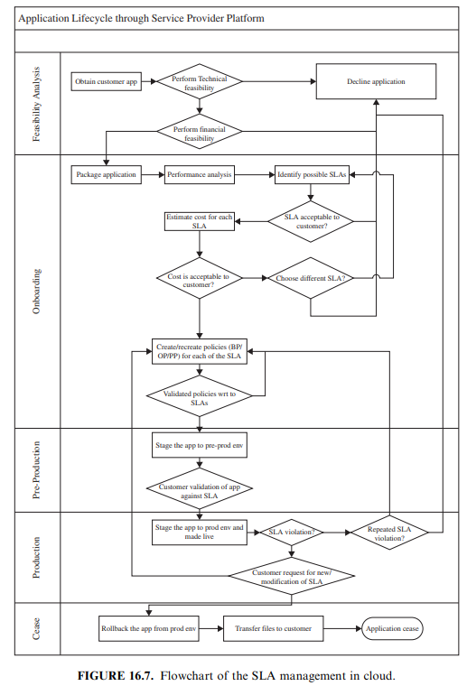

Slide 25
Feasibility Analysis
MSP (Managed Service Provider) conducts the feasibility study of hosting an application on their cloud platforms. This study involves three kinds of feasibility:
(1) technical feasibility,
(2) infrastructure feasibility, and
(3) financial feasibility.
Technical feasibility:
1. Ability of an application to scale out.
2. Compatibility of the application with the cloud platform being used within the MSP’s data center.
3. Need and availability of a specific hardware and software required for hosting and running of the application.
4. Preliminary information about the application performance and whether they can be met by the MSP.

Slide 26
Infrastructure feasibility
- determining the availability of infrastructural resources in sufficient quantity so that the projected demands of the application can be met.
Financial feasibility
- determining the approximate cost to be incurred by the MSP &
- price the MSP charges the customer
- so that the hosting activity is profitable to both of them.
A feasibility report consists of the results of the above three feasibility studies.
The report forms the basis for further communication with the customer.
Once the provider and customer agree upon the findings of the report, the outsourcing of the application hosting activity proceeds to the next phase, called “onboarding” of application.

Slide 27
On-Boarding of Application
Moving an application to the MSP’s hosting platform is called on-boarding.
As part of the on-boarding activity, the MSP understands the application runtime characteristics using runtime profilers.
This helps the MSP to identify the possible SLAs that can be offered to the customer for that application.
This also helps in creation of the necessary policies (also called rule sets) required to guarantee the SLOs mentioned in the application SLA.
The application is accessible to its end users only after the onboarding activity is completed.

Slide 28
On-boarding activity consists of the following steps:
a. Packing of the application for deploying on physical or virtual environments.
Application packaging is the process of creating deployable components on the hosting platform (could be physical or virtual).
Open Virtualization Format (OVF) standard is used for packaging the application for cloud platform.
b. The packaged application is executed directly on the physical servers to capture and analyze the application performance characteristics.
Additionally, it helps to identify the nature of application—that is, whether it is CPU-intensive or I/O intensive or network-intensive and the potential performance bottlenecks.
c. The application is executed on a virtualized platform and the application performance characteristics are noted again.
Important performance characteristics like the application’s ability to scale (out and up) and performance bounds (minimum and maximum performance) are noted.

Slide 29


d. Based on the measured performance characteristics, different possible SLAs are identified.
The resources required and the costs involved for each SLA are also computed.
e. Once the customer agrees to the set of SLOs and the cost, the MSP starts creating different policies.
These policies are of three types: (1) business, (2) operational, and (3) provisioning.
Business policies help prioritize access to the resources in case of contentions. Business policies are in the form of weights for different customers or group of customers.
Operational policies are the actions to be taken when different thresholds/conditions are reached.
Operational policies (OP) are represented in the following format:
Ex:

Slide 30
Provisioning policies help in defining a sequence of actions corresponding to external inputs or user requests.
Scale-out, scale-in, start, stop, suspend, resume are some of the examples of provisioning actions.
A provisioning policy (PP) is represented as:
Ex: Provisioning policy to start a web site consists of the following sequence: start database server, start web-server instance 1, followed by start the web-server instance 2, and so on.
On defining these policies, the packaged applications are deployed on the cloud platform and the application is tested to validate whether the policies are able to meet the SLA requirements.
This step is iterative and is repeated until all the infrastructure conditions necessary to satisfy the application SLA are identified.
Once the different infrastructure policies needed to guarantee the SLOs mentioned in the SLA are completely captured, the on-boarding activity is said to be completed.

Slide 31
Preproduction
It facilitates the customer to verify and validate the MSP’s findings on application’s runtime characteristics and agree on the defined SLA.
Once both parties agree on the cost and the terms and conditions of the SLA, the customer sign-off is obtained.
Successful completion of this phase the MSP allows the application to go on-live.
Production
In this phase, the application is made accessible to its end users under the agreed SLA.
Additionally, customer may request the MSP for inclusion of new terms and conditions in the SLA.
If the application SLA is breached frequently or if the customer requests for a new non-agreed SLA, the on-boarding process is performed again.

Slide 32
Termination
When the customer wishes to withdraw the hosted application and does not wish to continue to avail the services of the MSP for managing the hosting of its application, the termination activity is initiated.
On initiation of termination, all data related to the application are transferred to the customer and only the essential information is retained for legal compliance.
This ends the hosting relationship between the two parties for that application, and the customer sign-off is obtained.

